Slide 1
Module 2: Advanced IT Security
Cristina STOLOJESCU-CRISAN

Slide 2
Cryptography

Slide 3
Cryptography
Cryptography = the science of making and breaking secret codes
only the intended recipient can read or process it
greek origin:
κρυπτός kryptós (hidden)
γράφειν gráfein (to write)
by storing and transmitting encrypted data -> data protection
mathematical methods
1975 - IBM - DES (Data Encryption Standard)

Slide 4
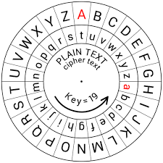
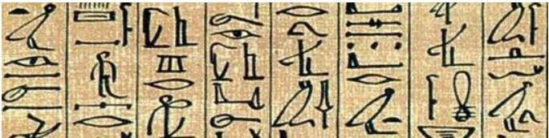
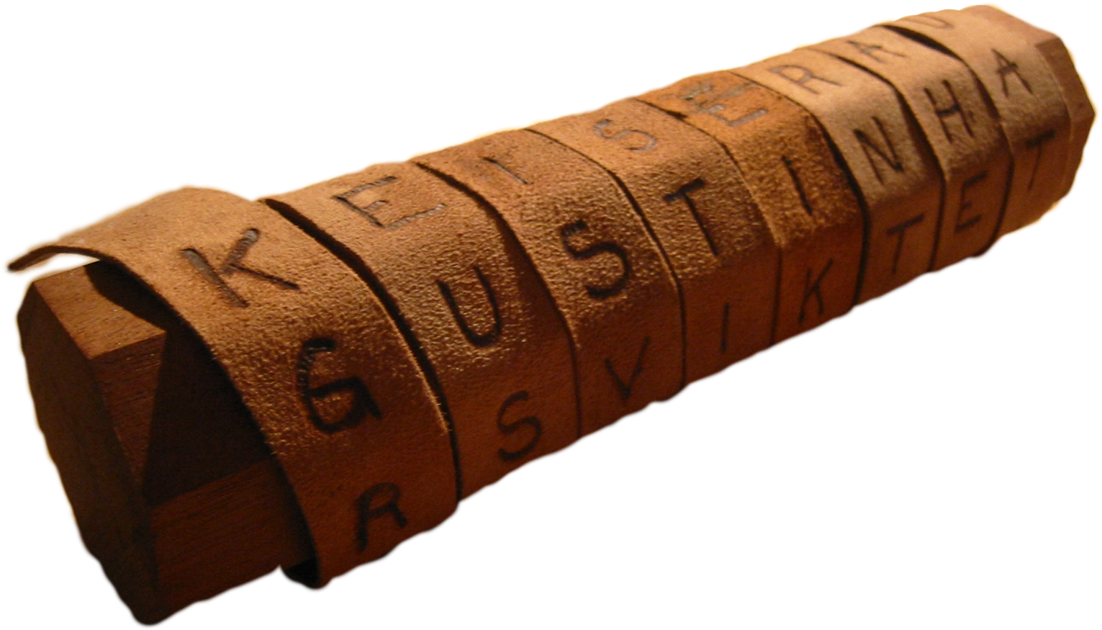
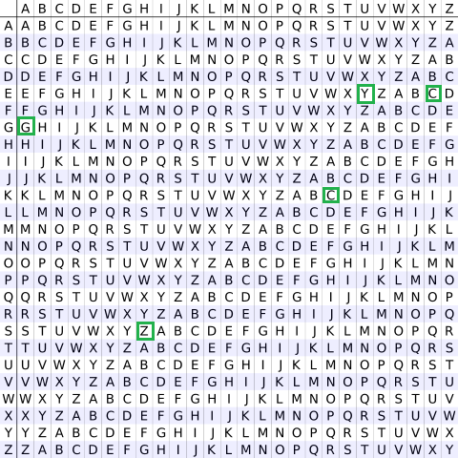
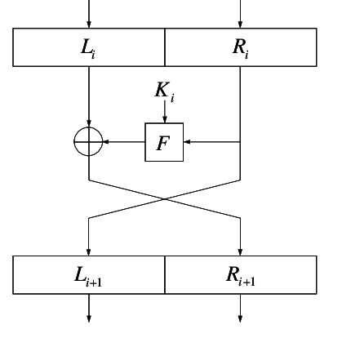
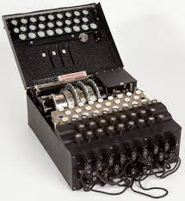
A Brief History of Cryptography

Slide 5
Cryptography Terms
Encryption
Plain text -> cipher text
Decryption
Cipher
Key
Steganography
Cryptanalysis

Slide 6
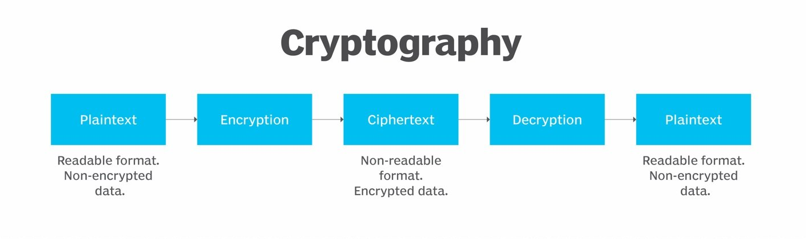
Image source: www.techtarget.com

Slide 7
Cryptographic objectives
Confidentiality
Integrity
Non-repudiation
Authentication

Slide 8
Creating Ciphertext
Key management
attacks on the key management system
cipher

Slide 9
Homework
What happens if someone tries to break an encryption algorithm?
Is encryption really secure?
Can encryption algorithms be broken?

